Slide 1
Annotations
Mekari 2015-16

Slide 2
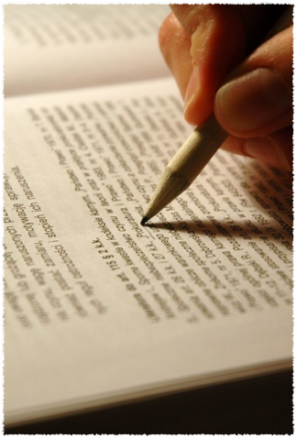
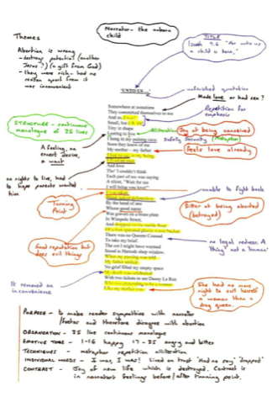
Annotations
Mekari 2015-2016

Slide 3
Prewriting
Writing requires you to think in advance!
Prewriting is ESSENTIAL to effective writing!
Even if you think you can successfully create a stream-of-consciousness essay - you will not be able to do that in this class!

Slide 4
Read
The first phase of annotation is reading.
Read:
First, read the passage blind. No notations!
Second, read for literary effect. Scan the passage carefully for style devices.
Third, read for understanding.

Slide 5
Dirty Annotation
There are three phases of annotations.
1. Dirty Annotation:
First, scan the text for specific literary elements and identify these elements in various colors on your text.
Second, review the text for themes, motifs, and overarching ideas. Write these ideas, including audience, mood, and theme on your paper. Consider drawing lines to the place in the text where you discovered this meaning.

Slide 6
Clean Annotation
Once you have dissected the text selection and have “spilled your ideas all over your paper in technicolor highlights,” isolate your ideas.
Clean Annotation:
First, what? What is being said in this text? What is the central message or purpose?
Second, why? Why is this message being shared? Who is the audience?
Third, by what literary methods is the author communicating his or her message?

Slide 7
Assessment
A typical assessment for the annotation of a selection will be a Power Paragraph. In it’s structured form, an analytical paragraph will have at least 8 sentences.

Slide 8
The formula will look like this:
Topic Sentence
Transition/Textual Truth for point 1
Evidence
Commentary 1
Commentary 2
Transition/Textual Truth for point 2
Evidence
Commentary 1
Commentary 2
Concluding Sentence
Note: Another assessment could be a thesis statement.
In the poem ___, written by ___, the poet addresses ____, in order to prove ____ through the use of ____.

Slide 9
Example: Metaphor; by Eve Merriam
Morning is
a new sheet of paper
for you to write on.
Whatever you want to say,
all day,
until night folds it up
and flies it away.
The bright words and the dark words
are gone
until dawn
and a new day
to write on.

Slide 10
Group Thesis

Slide 11
Group Power Paragraph

