Slide 1
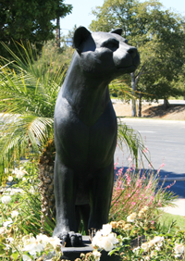
Welcome to Mrs. Mekari’s Class NPHS 12CP English

Slide 2
ABOUT YOUR TEACHER
Education/Degrees
Pepperdine Graduate School of Education and Philosophy –
MS Educational Leadership
Preliminary Administrative Credential
California Lutheran University
Clear Single Subject Credential – English
Clear Multiple Subject Credential – Elementary
BA – Liberal Studies
Work Experience
Newbury Park High School – English (current)
Pepperdine University – Adjunct Professor, Graduate School of
Education and Psychology (current)
Options For Youth Charter School, Curriculum Design (2007-2009)
Westlake High School - English (2005 – 2007)
West Valley Christian High School - English (2000-2005)
Trinity Christian Elementary School – 5th/6th Grade (1995-2000)

Slide 3
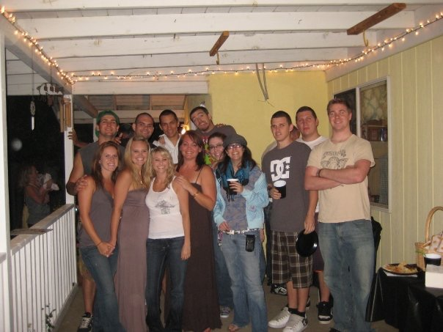
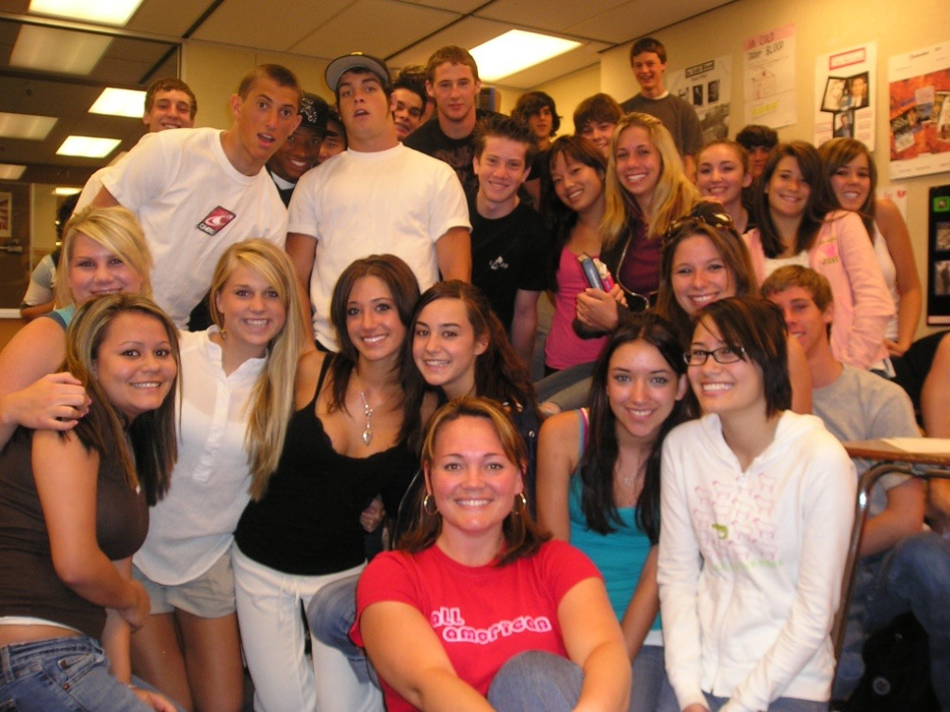
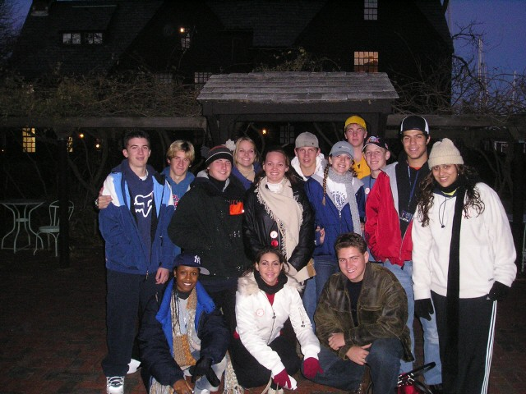
BEST JOB IN THE WORLD … (next to mom and wife!)

Slide 4
Course Overview
Quarter 1: REFLECTING ON SOCIETY | Quarter 2: FACING THE FUTURE AND CONFRONTING THE PAST
Period: Anglo-Saxon Approximate Time Frame: 1100 AD - 1400 AD Anchor Texts: from Beowulf (Whole Group) from The Canterbury Tales (Small Group) Writing Activities: Expository Essay Personal Response Creative Task(s) Supplementary Texts: Articles on Music as Social Commentary (Independent Study) | Period: Renaissance Approximate Time Frame: 1500 AD - 1600 AD Anchor Texts: “Hamlet” (Whole Group) Sonnets - Spencer, Sidney, and Shakespeare (Small Group) Writing Activitiess Expository Essay Personal Response Creative Task(s) Supplementary Texts: King James’ Bible selections (Independent Study)
Quarter 3: DISCOVERING THE SELF | Quarter 4: SEEING THINGS NEW; VISIONARIES AND SKEPTICS
Period: Romantic/Victorian Approximate Time Frame: 1800 AD- 1900 AD Anchor Texts: Dr. Jekyll and Mr. Hyde (Whole Group) “The Imp of the Perverse” (Small Group) Scottish Poets - Burns and Bailee (Whole/Small Group) Poetry of Suckley, Herrick, and Merrill (Whole/Small Group) Writing Activities: Expository Essay Personal Response Creative Task(s) Supplementary Texts: Dickens and Bronte; Public Education (Independent Study) | Period: Modern/Post-Modern Approximate Time Frame: 1900’s AD Anchor Texts: “The Importance of Being Earnest” (Whole Group) Brave New World (Small Group) Essay Style: Expository Essay Personal Response Creative Task(s) Supplementary Texts: Article on Dystopia in 21st Century (Independent Study)

Slide 5
Course Grade Values
Term 1 | Points | Term 2 | Points
Creative Task |  | Creative Task
Q1 Boast (Beowulf) Q1 Exemplum (Canterbury) | 50 pts. 50 pts. | Q3 POE-try (E.A. Poe) Q3 Advertisement (Dr. J & Mr. H) | 50 pts. 50 pts.
Q2 Sonnets (Sonnets) Q2 Soliloquy (Hamlet) | 50 pts. 50 pts. | Q4 Modern Art Excerpt (Surrealism) Q4 Social Poem (War Poetry) | 50 pts. 50 pts.
Literary Analysis Essay |  | Literary Analysis Essay
Q1 Reflecting on Society | 100 pts. | Q3 Discovering the Self | 100 pts.
Q2 Facing the Future and Confronting the Past | 100 pts. | Q4 Visionaries and Skeptics | 100 pts.
Comparative Writing |  | Comparative Writing
Music as Social Commentary | 50 pts. | Public Education - Social Commentary | 50 pts.
KJB - Social Commentary | 50 pts. | Dystopia in 21st Century - Social Commentary | 50 pts.
Participation | 50 pts. | Participation | 50 pts.
Quizzes | 50 pts. | Quizzes | 50 pts.
BA First Term | 100 pts. | BA Second Term | 200 pts.
Coursework Notebook | 100 pts. | Coursework Notebook | 100 pts.
Mid-Term Exam | 200 pts. | Senior Reflection | 100 pts.
Total | 1000 pts. | Final Exam | 200 pts.
 |  | Total | 1200 pts.

Slide 6
Classwork/Homework
Coursework Notebook - This will contain all lecture notes, in class writing and drafting assignments, and miscellaneous activities.
Be prepared with all reading completed and ready to discuss
Submit work to turnitin.com in a timely manner. Work submitted late will be given credit at teacher’s discretion.
Use class time wisely, and there will rarely be homework.
Benchmark Assessment - This research paper is imperative to passing this class. It is constructed over a three month period and is primarily done at home.

Slide 7
Assessments
Expository Essay: Students will complete one 4-6 paragraph essay per unit of instruction. 100 pts.
Creative Task(s): Students will write two creative tasks per unit that model the selections studied. 50 pts.
Oral Presentation: Students will give an oral presentation of the creative tasks in Term 1.
Personal Response: Students will write a short reflective response to a topic worthy of social commentary for each unit. 50 pts.

Slide 8
Stay Connected
Talk to your student!
Encourage them to advocate for themselves.
Use my website to stay informed on agenda items and homework.
http://smekarinphs.weebly.com
Q will be updated each progress period (approximately the 4 week mark).
Practice will not always be graded - this is why we keep notebooks.

Slide 9
What Do I Expect From My Students?
Respect – for me, themselves, their peers, for literature, and for learning
Honesty – academic honesty and personal integrity
Attention – undivided attention and mutual respect
Effort – the best they each have to give academically, personally, and creatively
Creativity – in thinking, speaking, and writing
Voice – speak up, student opinions are valid and will be heard and respected
Patience – bumps, adjustments, and delays are inevitable! ☺

