Slide 1
Unit 1 Essay Review
12 CP - British Literature

Slide 2
Essay Housekeeping
FORMATTING
Heading - Name, Period, Date?
Standard Font?
Creative Title?
Double-spaced?
No double gap between paragraphs?
Indented paragraphs?
Incorporate quotes?
Citations
MECHANICS
Sentences have capitals?
Spelling? Look for the obvious!
IM Speak? NO!
Contractions? NO!
Lower case “i” as a personal pronoun … I will lose my mind!!!!
Grammar - make sure you write what you meant to write.
Commas- And - Or - Nor - For But - Yet - So: Preceded by commas!

Slide 3
CONTENT
Does your opening paragraph have at LEAST 3 sentences?
Does your closing paragraph have at LEAST 3 sentences?
If they have the minimum, consider adding more for depth.
Do you have ENOUGH evidence to support your paragraph (usually two quotes per)
Do any of your paragraphs END on a quote? NO!

Slide 4
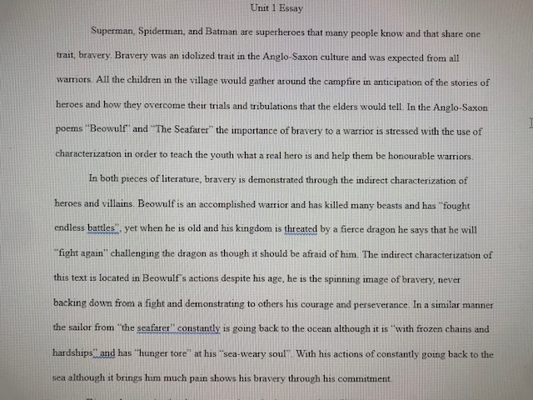

Slide 5
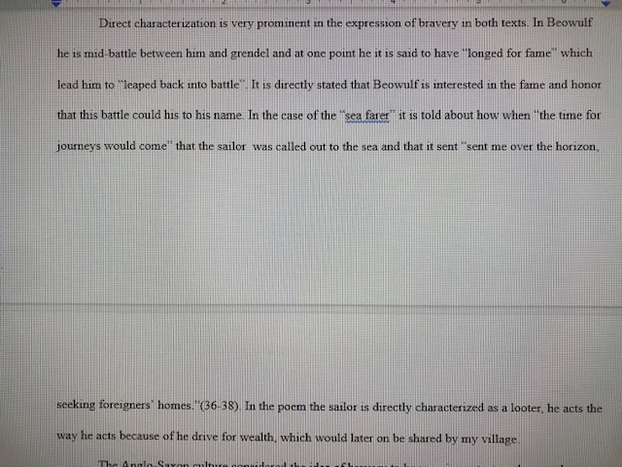

Slide 6
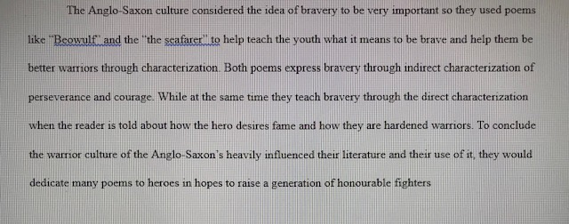

Slide 7
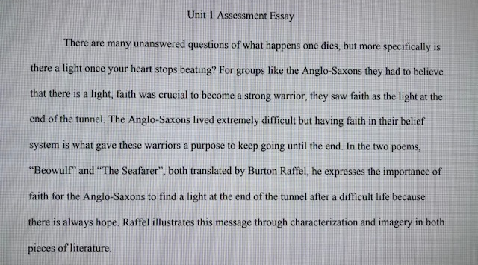

Slide 8
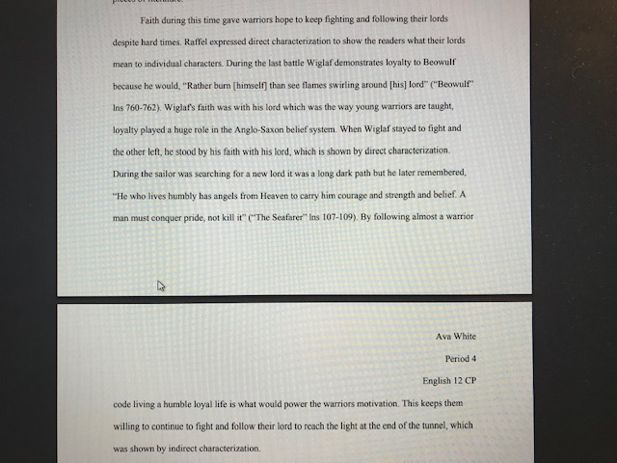

Slide 9
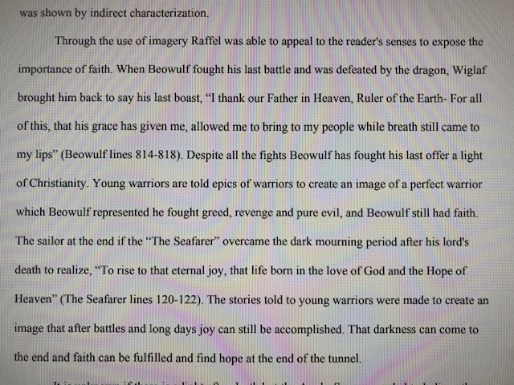

Slide 10
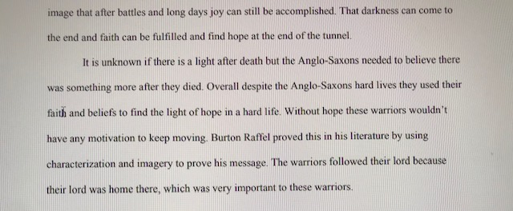

Slide 11
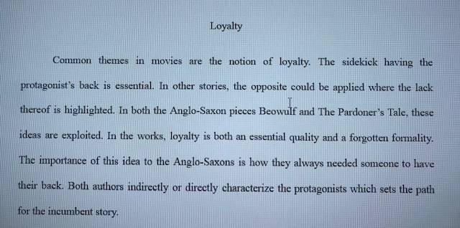

Slide 12
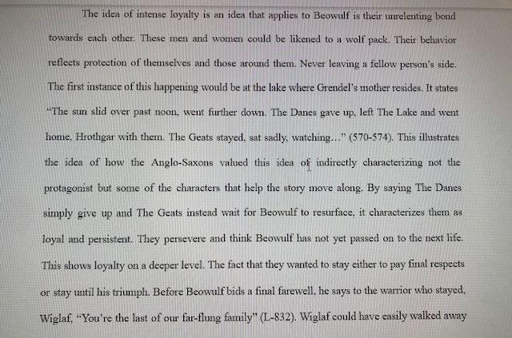

Slide 14
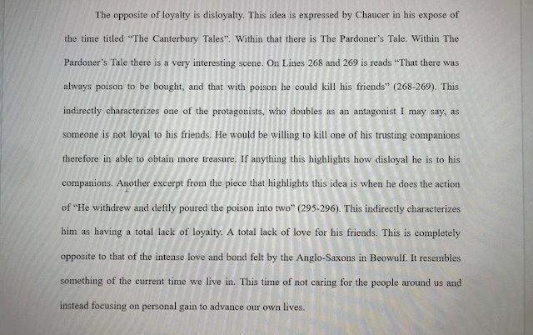

Slide 15
