Slide 1
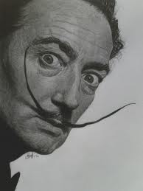
Modern art Focus: Salvador Dali
Please choose one of the following pictures (or look one up on your own) and write creative excerpt. Write at least 3 paragraphs and keep in mind the modernist influence of both realism and naturalism. Utilize creative, stylistic devices to accomplish your vision. Try focusing on character, perspective, setting, or conflict.

Slide 2
Premonition of the civil war Dali

Slide 3
Le Rose Dali

Slide 4
Metamorphosis of Narcissus dali

Slide 5
Archeological reminiscence … dali

Slide 6
Burning giraffe dali

Slide 7
DALI Burning Giraffe (woman with drawers)

Slide 8
Elephants dali

Slide 9
The Ship dALI

Slide 10
Paranoiac visage DALI

Slide 11
Sustained Comedy Hartley

Slide 12
Not to be reproduced Magritte

Slide 13
Le Demoiselle Picasso

Slide 14
Composition #10 Mondrian

Slide 15
The fireside angel ernst

Slide 16
Weeping woman picasso

Slide 17
Flamenco dancer

